Slide 1

Falcon 9 Reusability: A Predictive Analytics Study of First Stage Landings

Slide 2
Presentation Overview
Executive Summary
Introduction
Approach
Results
Conclusion

Slide 3
Executive Summary
Summary of methodologies
Data Collection
Data wrangling
EDA with Interactive visual analytics
EDA with SQL
Interactive map with Folium
Plotly Dash dashboard
Predictive Analysis (classification)
Summary of Results
EDA Results
Interactive Analysis
Prective Analysis

Slide 4
Introduction
Context and Background of the Project
SpaceX advertises Falcon 9 rocket launches on its website with a cost of 62 million dollars; other providers cost upward of 165 million dollars each, much of the savings is because SpaceX can reuse the first stage.
Challenges to Address
The Capestone project task is to predict if the Falcon 9 first stage will land successfully.

Slide 5
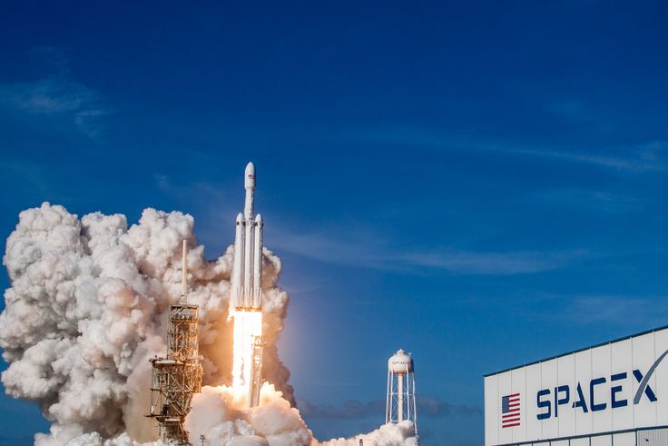
Approach

Slide 6
Approach
Executive Summary
Data Collection Methodology
Accessed data via SpaceX REST API
Conducted web scraping from Wikipedia.
Perform Data Wrangling
Data Cleaning: Managed null values and removed irrelevant columns.
Feature Engineering: Applied one-hot encoding to categorical data fields.successfully.
Perform exploitary data analysis (EDA) using visualization and SQL.
Perform interactive visual analysis using Folium and Plotly Dash
Perform predictive analysis using classification models
LR, KNN, SVM, DT models have been built and evaluated for the best classifier.

Slide 7
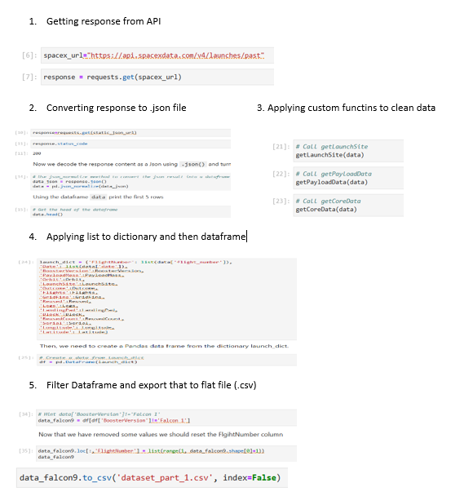
Data Collection – SpaceX REST API
Data collection with SpaceX REST API.
https://github.com/manishalinguntla2808/Applied-Data-Science-Capstone-Project/blob/main/Notebooks/jupyter-labs-spacex-data-collection-api.ipynb

Slide 8
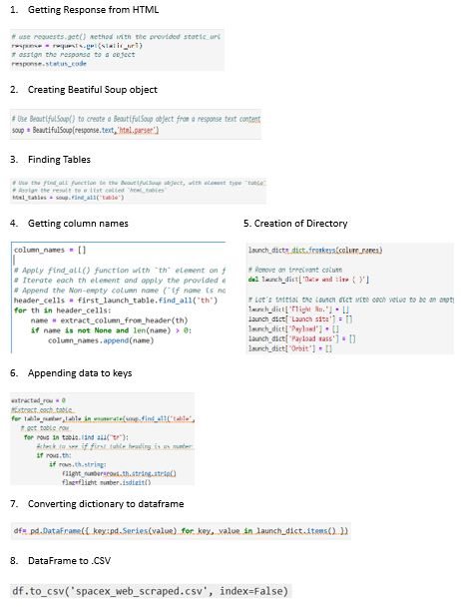
Data Collection – Web Scrapping
Web scraping to collect Falcon 9 historical launch records from a Wikipedia page titled List of Falcon 9 and Falcon Heavy launches.
https://github.com/manishalinguntla2808/Applied-Data-Science-Capstone-Project/blob/main/Notebooks/jupyter-labs-webscraping.ipynb

Slide 9
Data Wrangling
Calculate the number of launches on each site
Checking null values
Export the values to csv
Calculate the number and occurance of each orbit
Calculate the number and accurance of mission outcomes of the orbit
Creating a landing outcome label from outcome column
https://github.com/manishalinguntla2808/Applied-Data-Science-Capstone-Project/blob/main/Notebooks/labs-jupyter-spacex-Data%20wrangling.ipynb

Slide 10
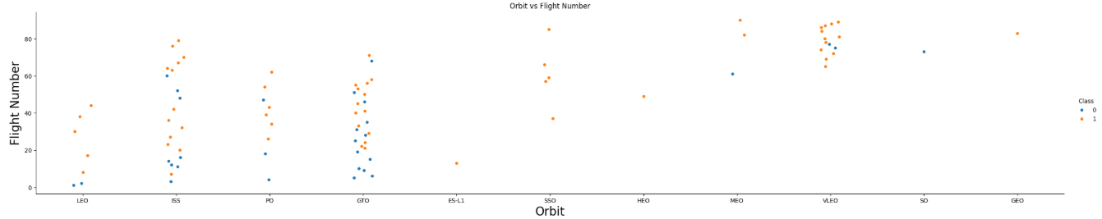
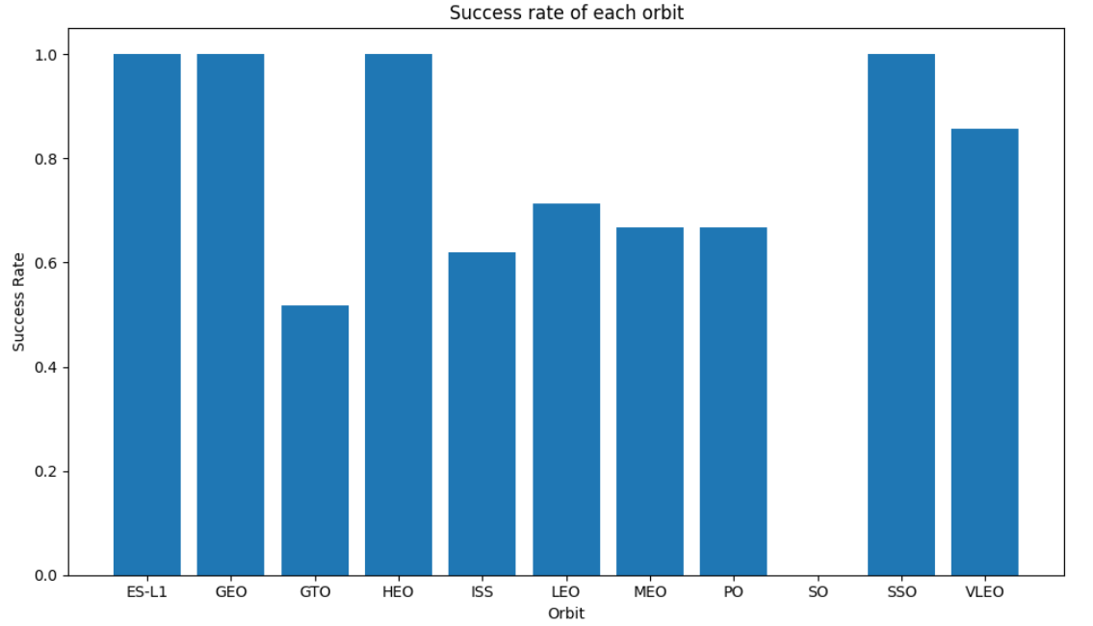
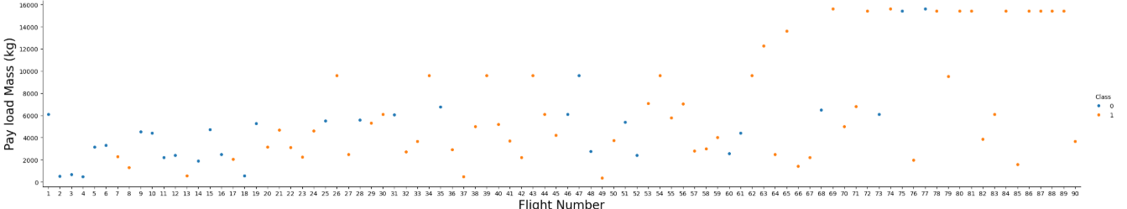
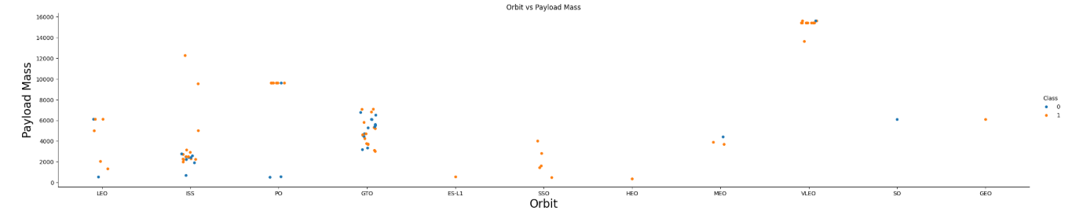
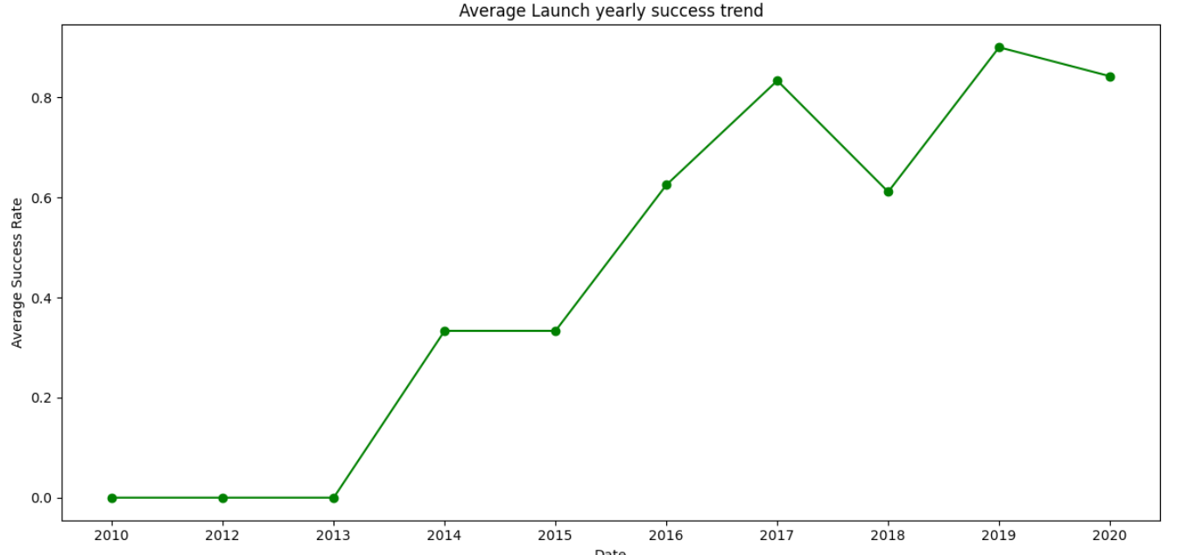
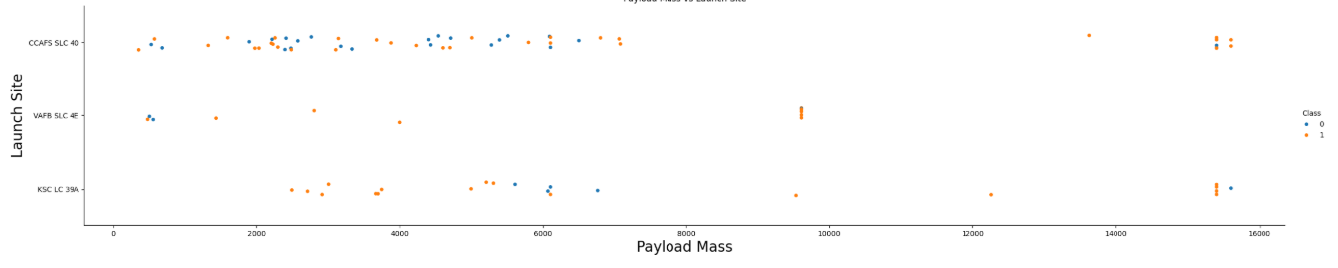
EDA with Data Visualization

Slide 11
EDA with SQL
SQL queries performed include:
Displaying the names of the unique launch sites in the space mission.
Displaying 5 records where launch sites begin with the string 'CCA’.
Displaying the total payload mass carried by boosters launched by NASA (CRS).
Displaying average payload mass carried by booster version F9 v1.1.
Listing the date where the first succesful landing outcome in ground pad was acheived.
Listing the names of the boosters which have success in drone ship and have payload mass greater than 4000 but less than 6000.
Listing the total number of successful and failure mission outcomes.
Listing all the booster_versions that have carried the maximum payload mass. Use a subquery.
Listing the records which will display the month names, failure landing_outcomes in drone ship ,booster versions, launch_site for the months in year 2015.
Ranking the count of landing outcomes (such as Failure (drone ship) or Success (ground pad)) between the date 2010-06-04 and 2017-03-20, in descending order.
https://github.com/manishalinguntla2808/Applied-Data-Science-Capstone-Project/blob/main/Notebooks/jupyter-labs-eda-sql-coursera_sqllite.ipynb

Slide 12
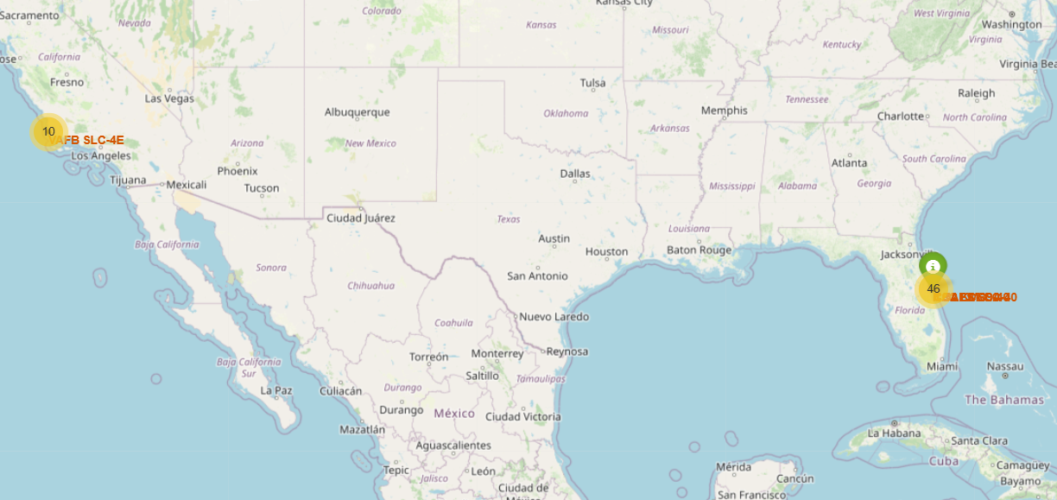
Interactive Map with Folium
Map markers have been added to assist in identifying the optimal location for constructing a new launch site.
https://github.com/manishalinguntla2808/Applied-Data-Science-Capstone-Project/blob/main/Notebooks/lab_jupyter_launch_site_location.ipynb

Slide 13
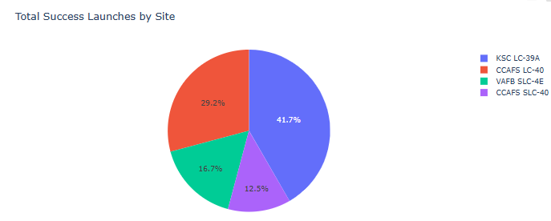
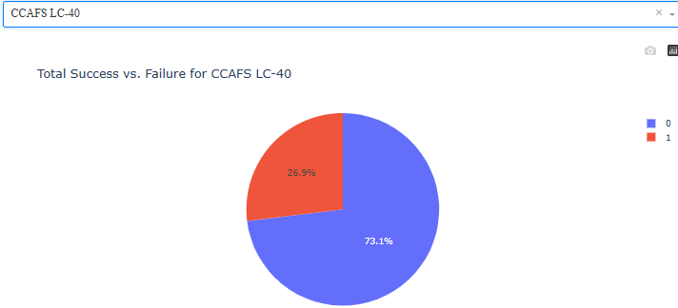
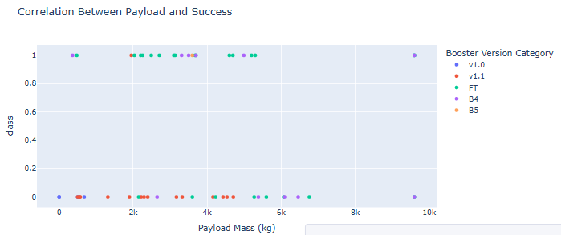
Dashboard Development with Plotly Dash
https://github.com/manishalinguntla2808/Applied-Data-Science-Capstone-Project/blob/main/Notebooks/spacex-dash-app.py

Slide 14
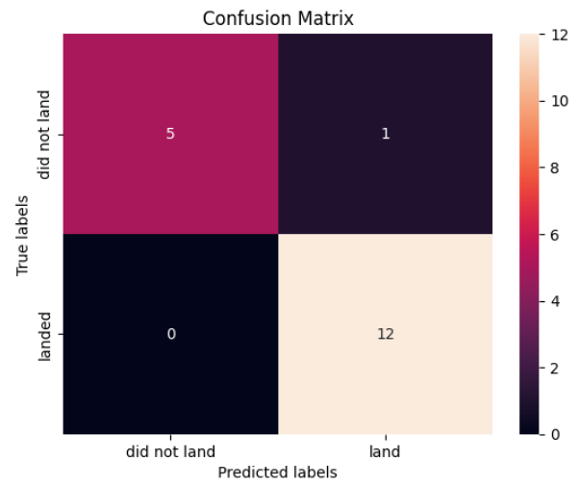
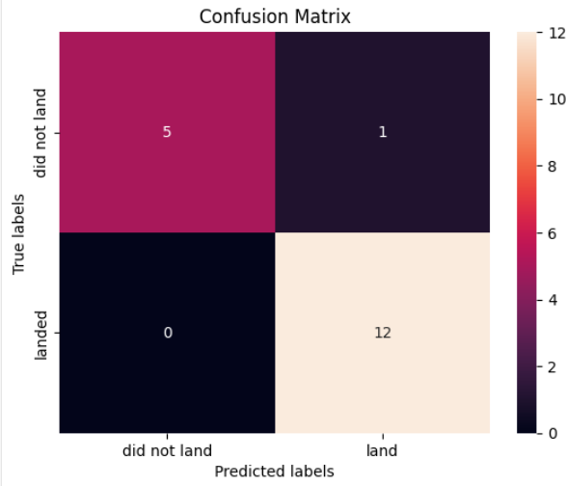
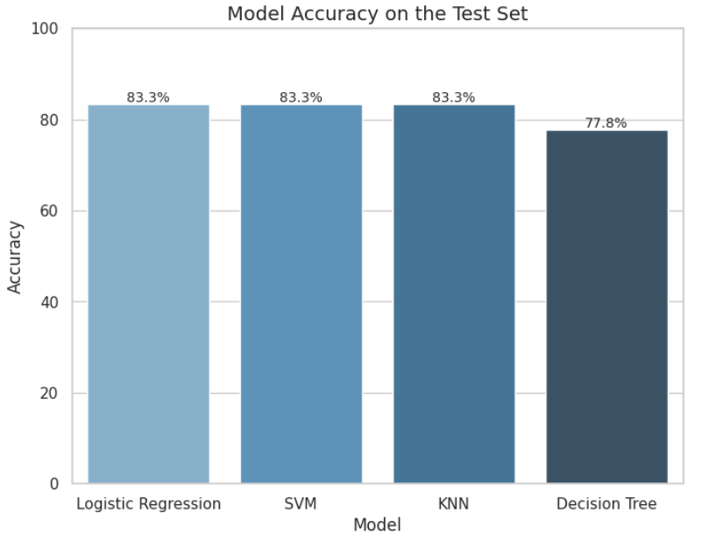
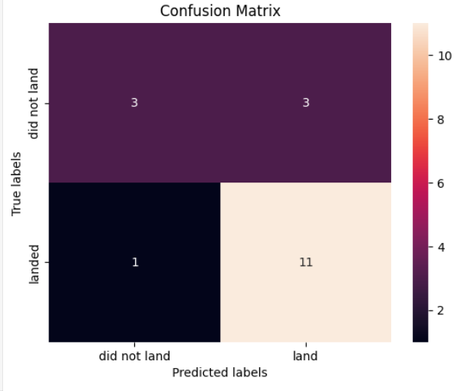
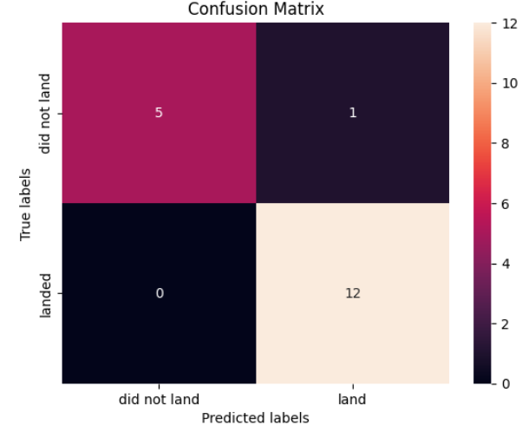
Predictive Analysis (Classification)
Logistic Regression, SVM, and KNN performed the best with 83.3% accuracy. Decision Tree had slightly lower accuracy at 77.8%. Overall, the first three models are better for this dataset.
https://github.com/manishalinguntla2808/Applied-Data-Science-Capstone-Project/blob/main/Notebooks/SpaceX_Machine%20Learning%20Prediction_Part_5.ipynb

Slide 15
Results
The SVM, KNN, and Logistic Regression models demonstrated the highest predictive accuracy on the dataset.
Launches with lower payload weights consistently achieved higher success rates.
Launch success rates have improved over time, reflecting ongoing enhancements in SpaceX’s operational efficiency.
The KSC LC-39A launch site recorded the highest number of successful launches across all locations.
Orbits such as GEO, HEO, SSO, and ES L1 exhibited the highest overall success rates.

Slide 16

Insights Gained from EDA

Slide 17
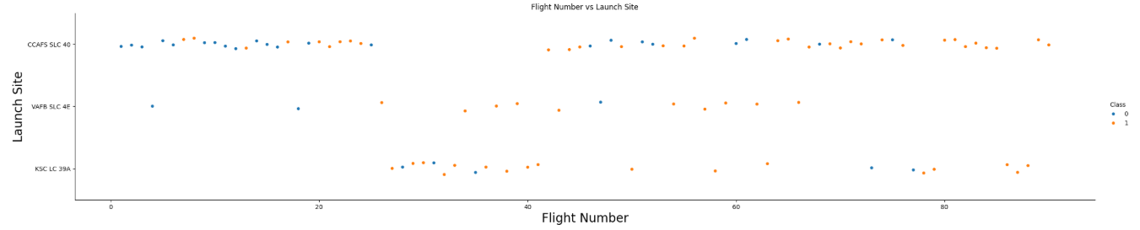
Flight Number vs Launch Site
The SVM, KNN, and Logistic Regression models demonstrated the highest predictive accuracy on the dataset.
Launch success rates improve with increasing flight number across all launch sites, indicating learning over time.

Slide 18
Flight Number vs Payload Mass
Higher payload mass launches tend to have more successful outcomes, especially in later flight numbers as experience increases.

Slide 19
Payload Mass vs Launch Site
Higher payload masses are mostly launched from CCAFS SLC-40, and these launches generally show a higher success rate.

Slide 20
Orbit Type vs Success rate
ES-L1, GEO, HEO, and SSO orbits exhibit a 100% success rate, while GTO has the lowest at approximately 52%.

Slide 21
Orbit Type vs Flight Number
Certain orbits like VLEO, ISS, and GTO show higher success rates, especially in later flights, indicating improved mission performance across different orbital destinations.

Slide 22
Orbit Type vs Payload Mass (Kg)
Higher payload capacities in VLEO (~15,600 kg), ISS (~12,000 kg), and PO (~10,000 kg) are associated with consistently strong launch success rates.

Slide 23
Annual Average Launch Success Rate Trend
The average launch success rate dramatically improved from 0% in 2013 to over 80% by 2017, largely maintaining high success through 2020 despite minor fluctuations.

Slide 24
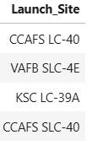
All Launch Site Names
%sql SELECT DISTINCT "Launch_Site" FROM SPACEXTBL;

Slide 25
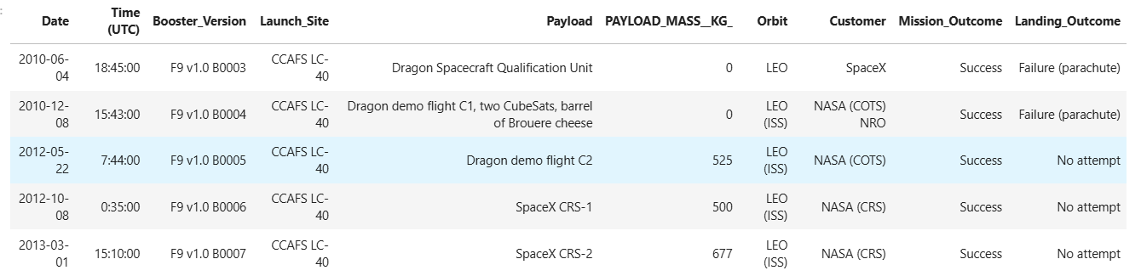
Launch site names begin with 'CCA’
%sql select * From SPACEXTBL where launch_site like 'CCA%' limit 5;

Slide 26
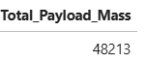
Total Payload Mass carried by NASA
%sql select sum(PAYLOAD_MASS__KG_) as Total_Payload_Mass from spacextbl where customer like '%NASA (CRS)%';

Slide 27
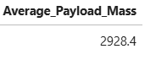
Average payload mass carried by version F9 v1.1
%sql select avg(PAYLOAD_MASS__KG_) as Average_Payload_Mass from spacextbl where booster_version like 'F9 v1.1';

Slide 28
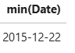
First succesful ground landing outcome
%sql select min(Date) from spacextbl where landing_outcome like '%ground pad%';

Slide 29
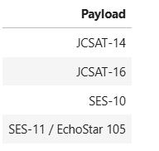
Successful Drone Ship Landing with payload mass between 4000 and 6000
%sql select (payload) from spacextbl where landing_outcome like '%Success (drone ship)%' and payload_mass__kg_ between 4000 and 6000;

Slide 30
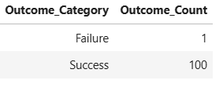
Total number of Success and Failure Mission Outcomes
%sql SELECT CASE WHEN TRIM("Mission_Outcome") LIKE 'Success%' THEN 'Success' ELSE 'Failure' END AS Outcome_Category, COUNT(*) AS Outcome_Count FROM SPACEXTBL GROUP BY Outcome_Category;

Slide 31
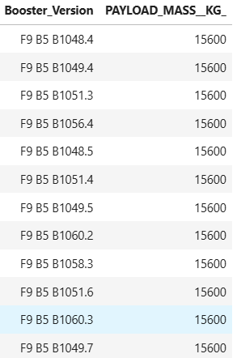
Boosters Carried Maximum Load
%sql select booster_version, payload_mass__kg_ from spacextbl where payload_mass__kg_ in (select max(payload_mass__kg_) from spacextbl);

Slide 32
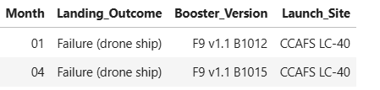
2015 Launch Records
%sql SELECT substr(Date,6,2) AS Month, "Landing_Outcome", "Booster_Version", "Launch_Site" FROM SPACEXTBL WHERE "Landing_Outcome" LIKE '%Failure (drone ship)%' AND substr(Date,1,4)='2015';

Slide 33
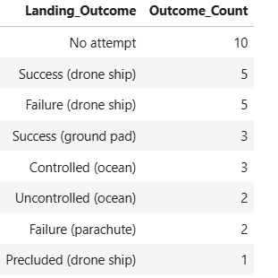
Rank the landing outcomes between 2010-06-04 and 2017-03-20
%sql SELECT "Landing_Outcome", COUNT(*) as Outcome_Count FROM SPACEXTBL WHERE Date BETWEEN '2010-06-04' AND '2017-03-20' GROUP BY "Landing_Outcome" ORDER BY Outcome_Count DESC;

Slide 34

Launch Sites Proximities Analysis

Slide 35
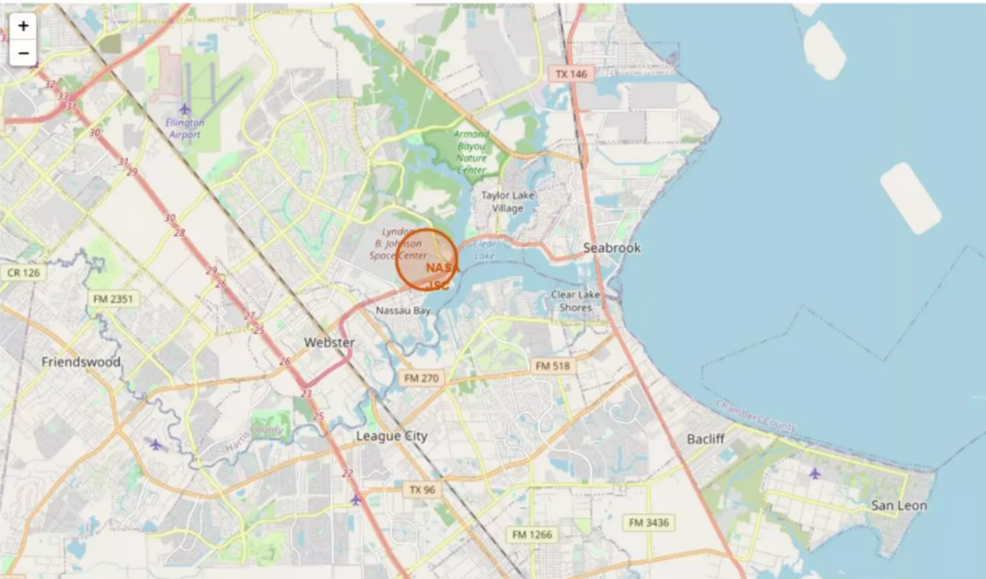
All Launch sites marked on Map

Slide 36
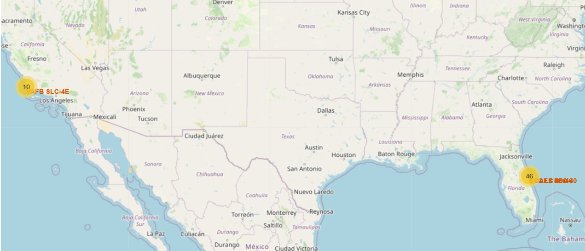
Launch Sites and Frequency in the USA

Slide 37

Dashboard with Plotly Dash

Slide 38
Total Successful Launches by Launch Site
KSC LC-39A leads with 41.7% of total successful launches, followed by CCAFS LC-40 at 29.2%, demonstrating the dominance of these two sites.

Slide 39
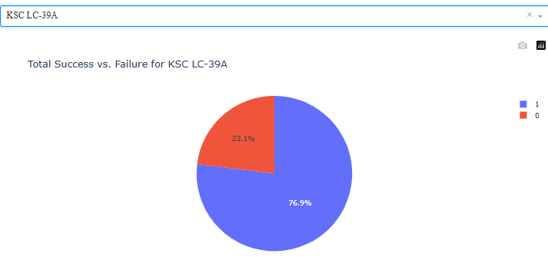
Success vs. Failure Rate for KSC LC-39A
KSC LC-39A has a high success rate of 76.9% for its launches, with failures accounting for the remaining 23.1%.

Slide 40
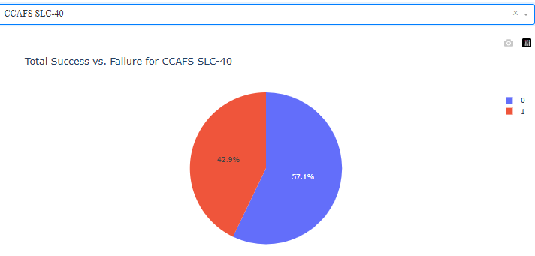
Success vs. Failure for CCAFS SLC-40
CCAFS SLC-40 has a success rate of 57.1% for its launches, with a significant failure rate of 42.9%.

Slide 41
Success vs. Failure for CCAFS LC-40
CCAFS LC-40 demonstrates a strong success rate of 73.1% for its launches, with failures accounting for 26.9%.

Slide 42
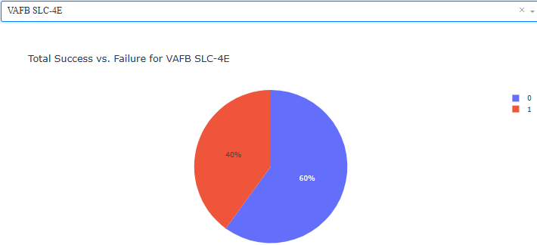
Success vs. Failure for VAFB SLC-4E
VAFB SLC-4E experiences a 60% success rate for its launches, with failures occurring in 40% of attempts.

Slide 43
Payload vs Launch outcome
Success rates for different booster versions demonstrate a clear progression, with later iterations (FT, B4, B5) exhibiting a significantly higher probability of mission success across a wider spectrum of payload masses compared to their predecessors (v1.0, v1.1).

Slide 44

Predictive Analysis (Classification)

Slide 45
Classification Accuracy

Slide 46
Confusion Matrix

Slide 47
Conclusions
Launch success improves as flight experience increases.
KSC LC-39A has the highest number of successful launches.
CCAFS SLC-40 handles more high-payload launches with good success rates.
Payloads between 2,000 kg and 8,000 kg show higher success rates.
Heavier payloads up to ~15,600 kg are successfully launched into VLEO, ISS, and PO orbits.
Orbits like VLEO, ISS, GTO, and PO show higher success rates.
Logistic Regression, SVM, and KNN models performed best, achieving 83.3% accuracy.
SpaceX’s success rates have improved over time due to technological advancements and operational learning.

Slide 48
Thank you

